Slide 1
WaiterBot

Slide 2
01
02
Creating the Package
URDF
03
04
Launching the Robot
Output
Creating a package for the robot
Creating the robot using a urdf file
Loading the URDF in rviz
The final robot

Slide 3
01.
Creating the Package

Slide 4
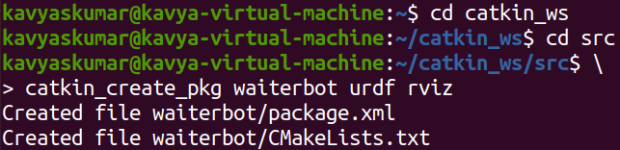
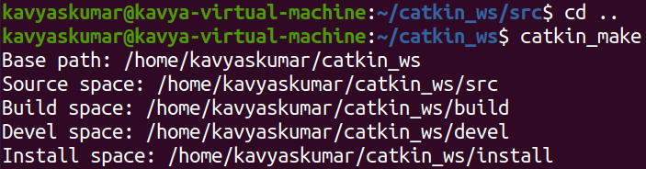
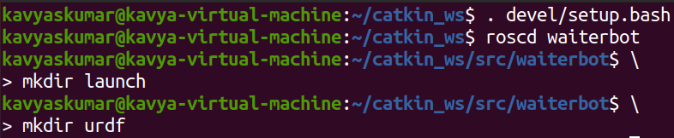
Inside the src folder of catkin workspace, create a package called “waiterbot” using the command
catkin_create_pkg waiterbot urdf rviz
Go to the catkin workspace and run the catkin_make command to build the workspace
catkin_make
Inside the waiterbot package, create launch and URDF folder for the files
mkdir launch
mkdir urdf

Slide 5
02.
URDF

Slide 6
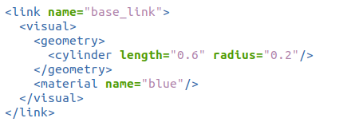
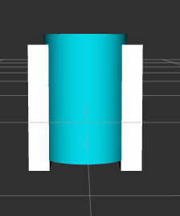
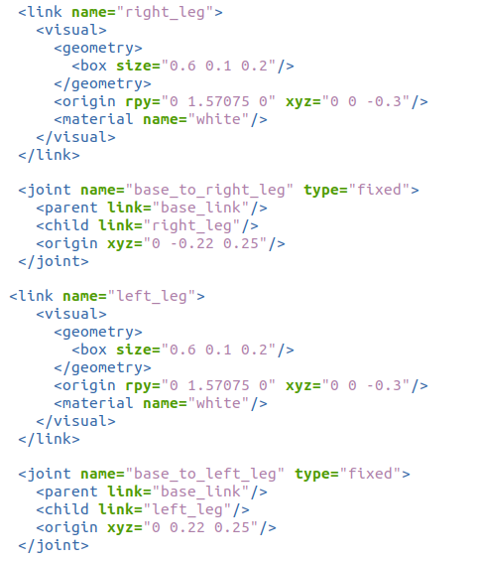
BASE & LEGS
Right Leg
Base Link
Left Leg

Slide 7
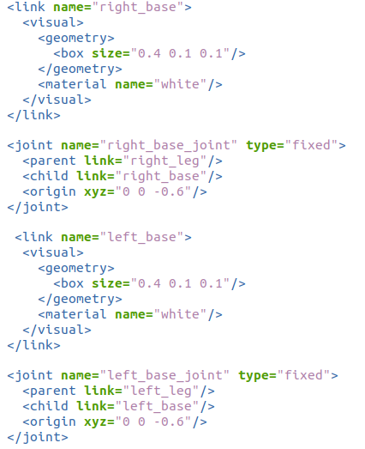
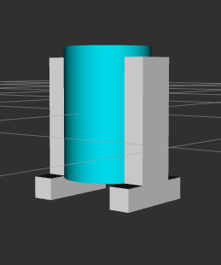
RIGHT AND LEFT BASE LINKS
Right Base
Left Base

Slide 8
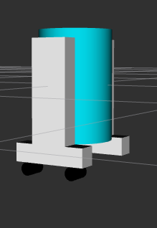
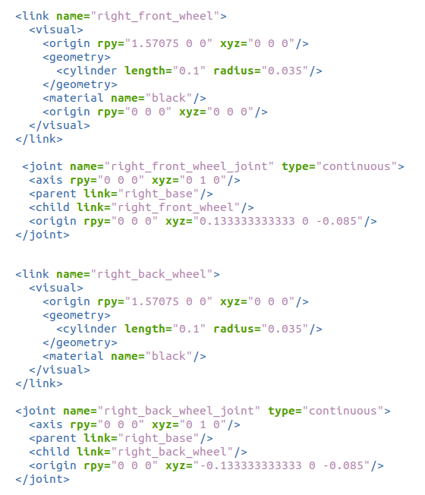
RIGHT FRONT AND BACK WHEEL
Right Back Wheel
Right Front Wheel

Slide 9
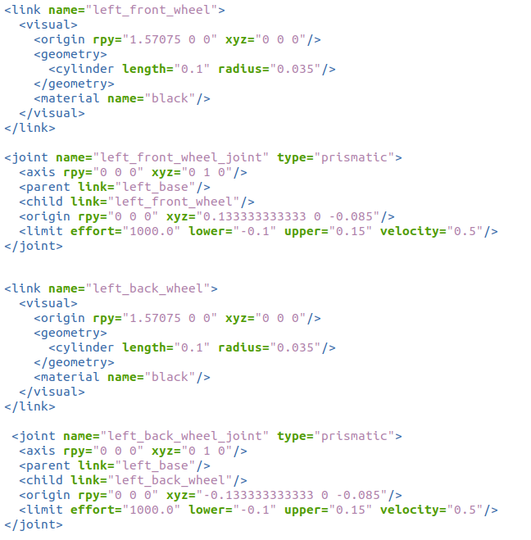
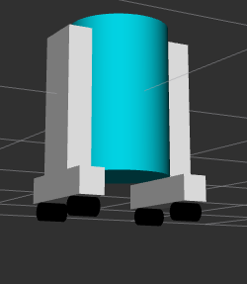
LEFT FRONT AND BACK WHEEL
Left Back Wheel
Left Front Wheel

Slide 10
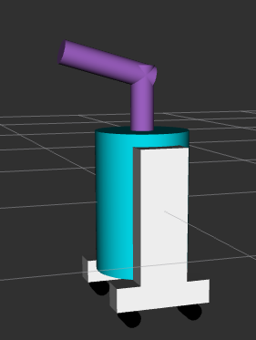
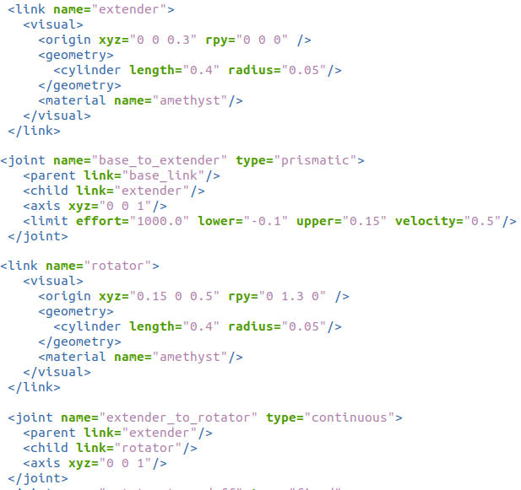
Extender & Rotator
Rotator
Extender

Slide 11
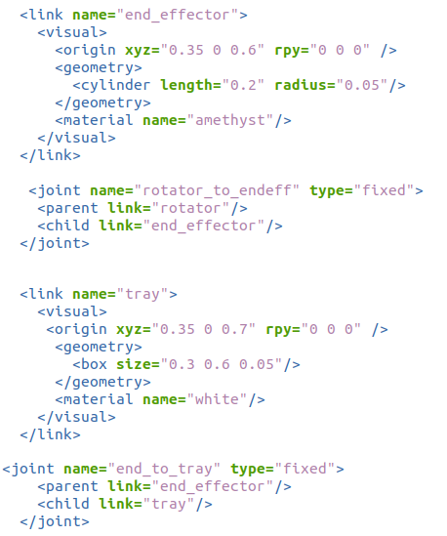
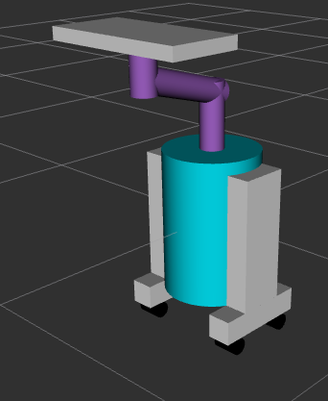
End Effector & Tray
Tray
End Effector

Slide 12
03.
Launching the Robot

Slide 13
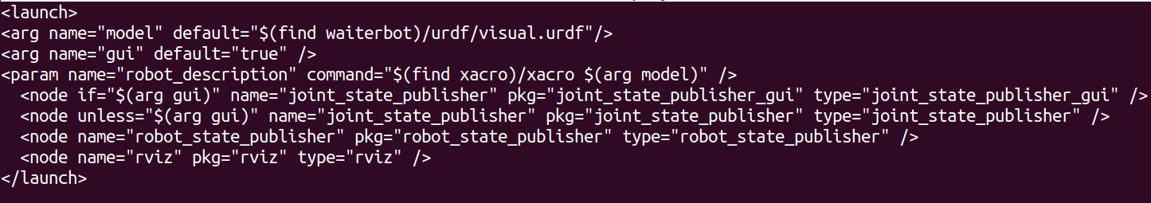
Inside the launch folder of the waiterbot package, create a .launch file
nano display.launch
The argument gui is used to control the robot
The joint_state_publisher finds all of the non-fixed joints and publishes a JointState message with all those joints defined
Since gui is present, the joint_state_publisher displays the joint positions in a window as sliders
The robot_state_publisher uses URDF specified by robot_description and joint_state_publisher to calculate the forward kinematics of the robot and publish the results.

Slide 14
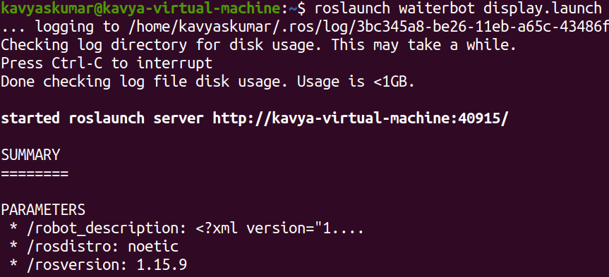
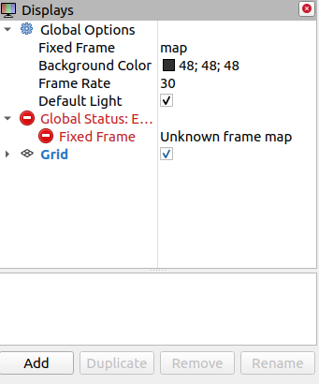
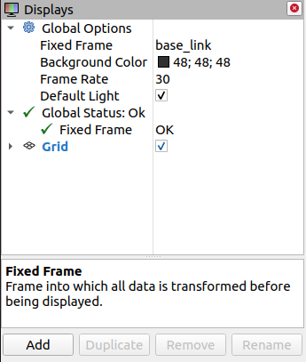
The following command, will launch rviz
roslaunch waiterbot display.launch
However, to display the robot, a few more configurations are needed
Change the “Fixed Frame” from map to base_link, then click “Add”

Slide 15
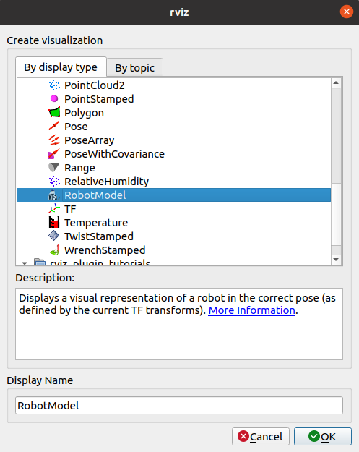
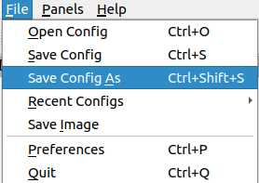
Select the robot model option
Now the robot will appear, once the robot appears:
Click on File
Click on Save configuration as
Save the file in the launch directory of the package as “config.rviz”
Add the line
args="-d $(find waiterbot)/launch/config.rviz“
required="true"
to the launch file
This will help directly load the robot file without any further configurations

Slide 16
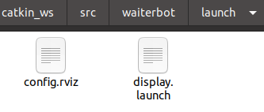
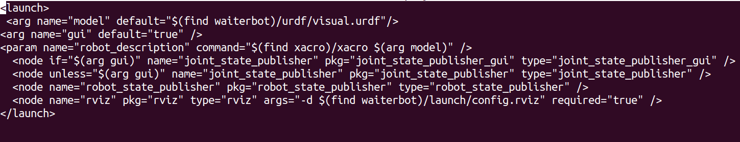
The launch directory
The new launch file

Slide 17

04.
Output

Slide 18
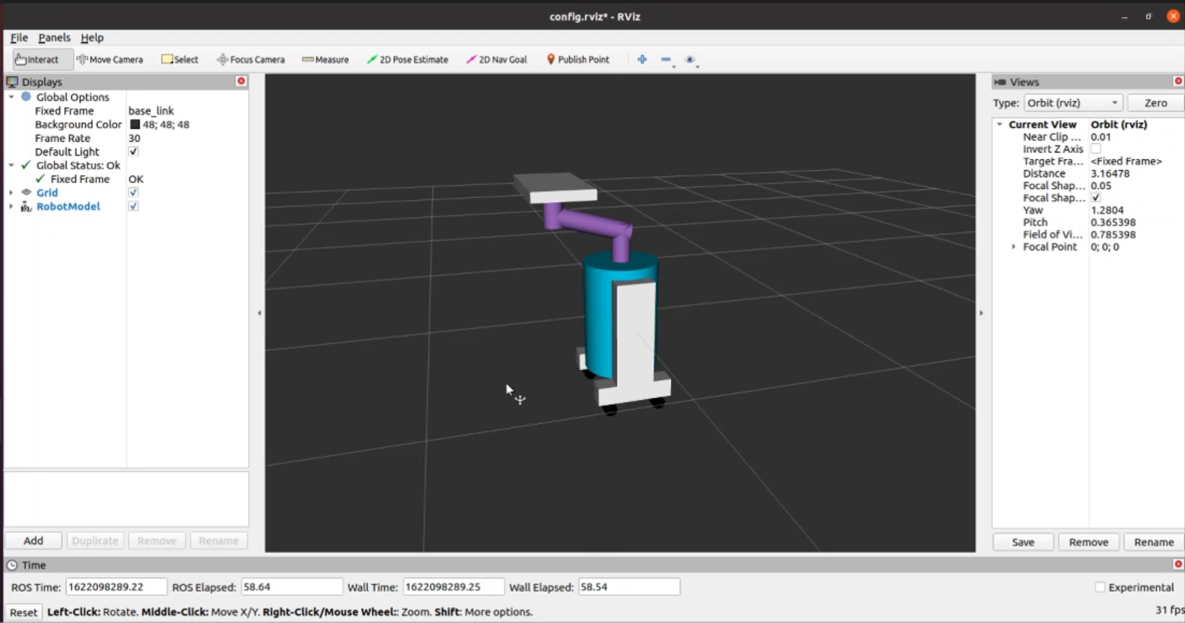

Slide 19
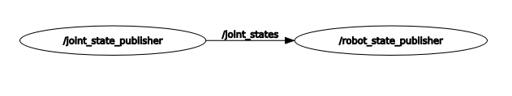
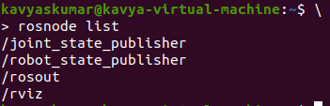
Rqt_graph
Nodes

Slide 20
THANK YOU!

